Slide 1
Project 2 – Predicting Ames Housing Sale Price
Shaun Kwek
DSI12

Slide 2
Problem Statement
What useful property information/data should be gathered for a more accurate prediction of Sale Price in Ames?
Instead of collecting every data (useful and not useful ones), we can help property agents to predict Sale Price of property in Ames with the model we came up using historical data.

Slide 3
Data Set given for evaluation
Train Dataset: all collected data
Test Dataset: all collected data, except Sale Price
Sale Price is the Target Variable
Using all the collected historical data in Train, we are to choose which data is more useful for prediction of Sale Price

Slide 4
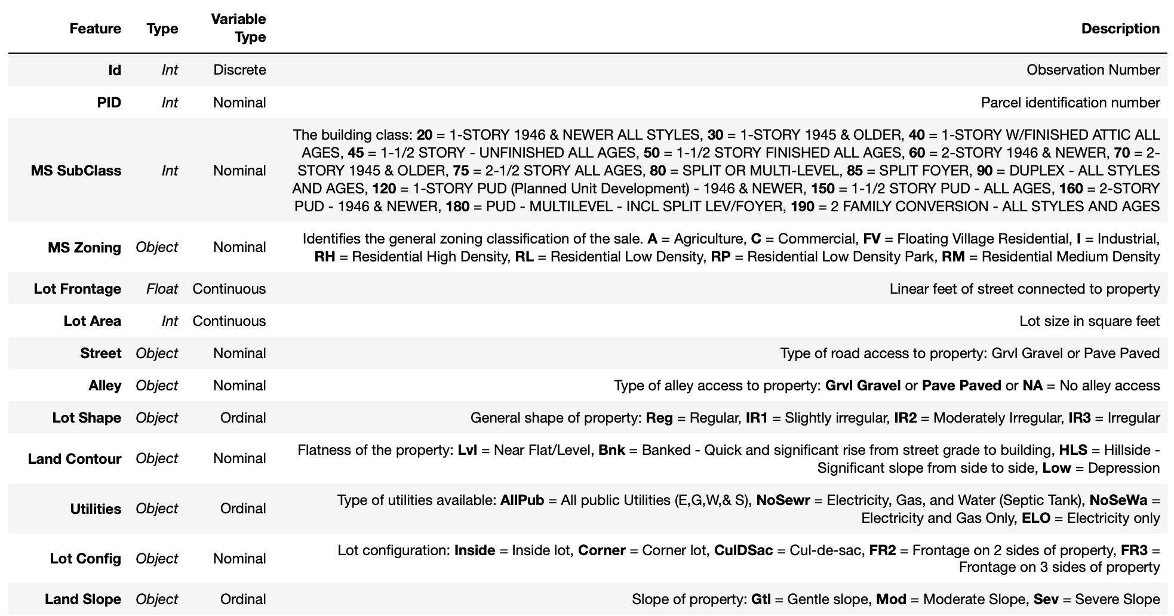
Data Dictionary

Slide 5
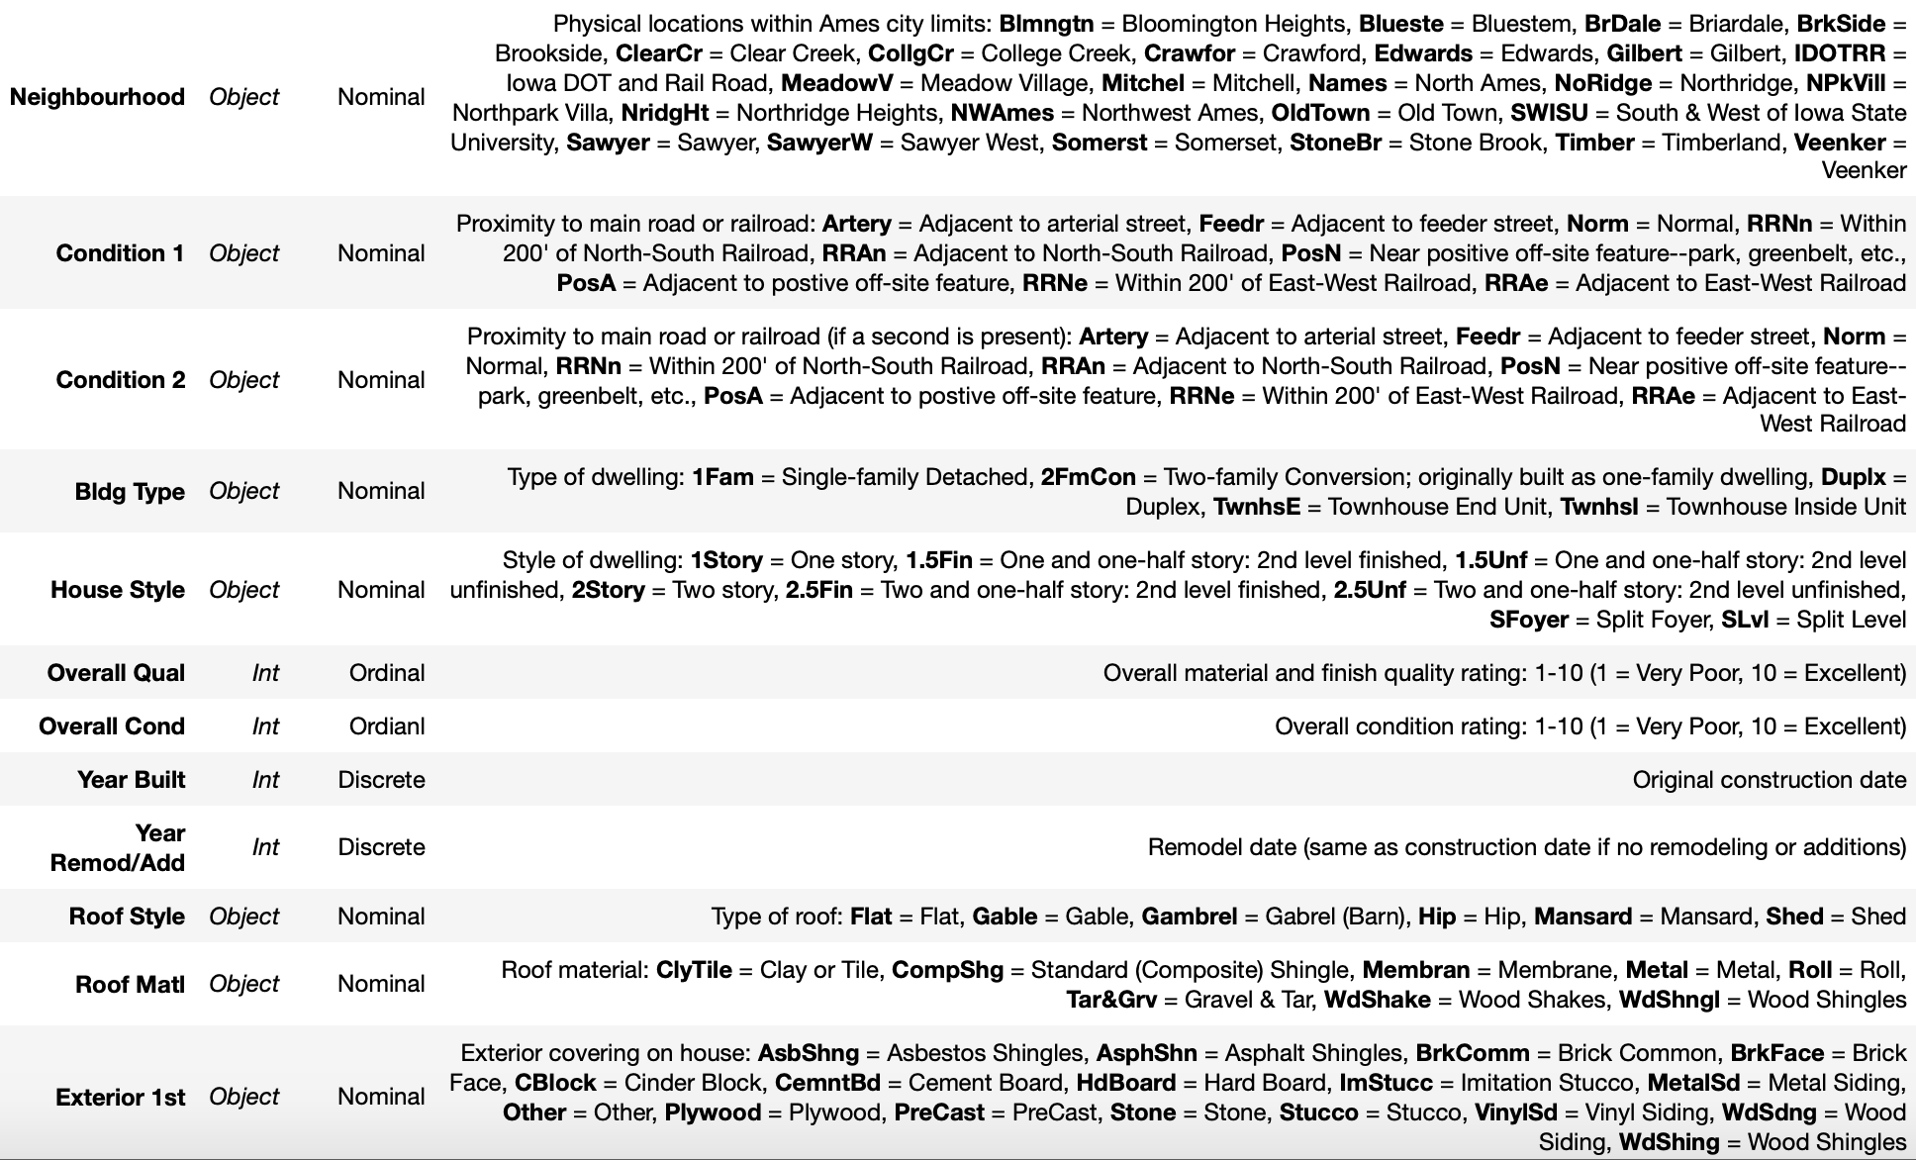
Data Dictionary

Slide 6
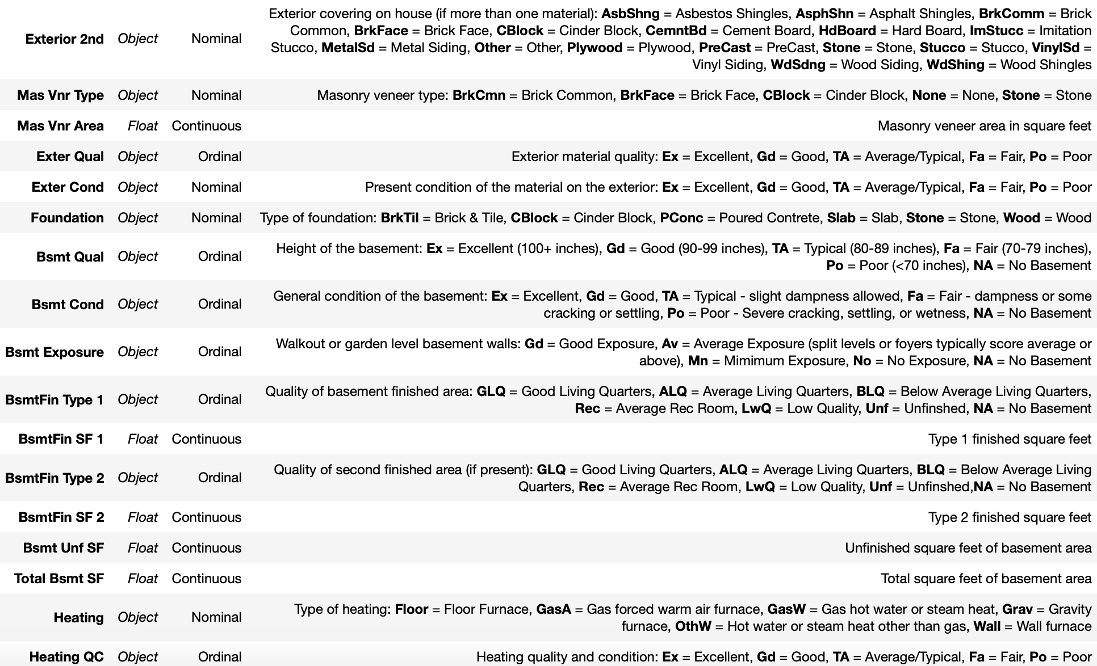
Data Dictionary

Slide 7
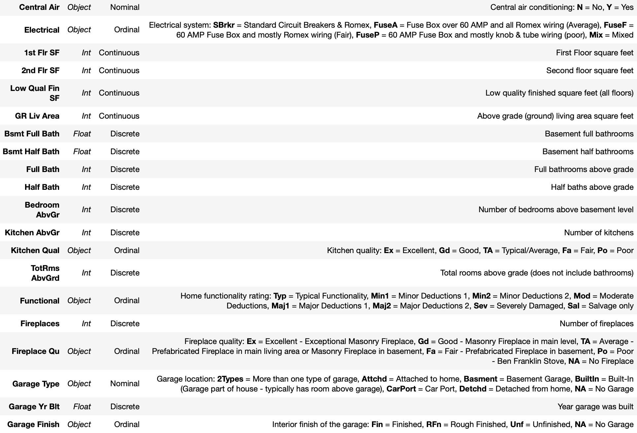
Data Dictionary

Slide 8
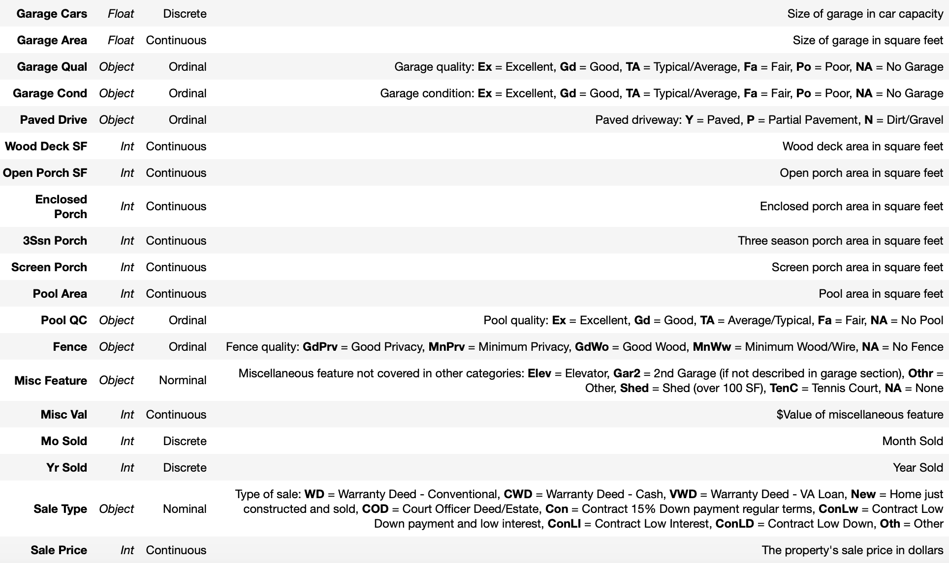
Data Dictionary

Slide 9
Data Cleaning – initial inspection
Removed outliers:
‘Gr Liv Area’ > 4000
Correcting incorrect data in ‘ Garage Yr Blt’
2207 to 2007, cross referenced to ‘Year Built’ indicated as 2006
Dropping Columns with similar/represented information:
Id
Garage Year Built (Year Built)
Garage Car (Garage Area)
BsmtFin SF 1 & BsmtFin SF 2 (Total Bsmt SF – Bsmt Unf SF)
1st Flr SF, 2nd Flr SF & Low Qual Fin SF (sum of those 3 = Gr Liv Area)

Slide 10
Feature engineering – Making sense with the Features
Remodelled Y/N
If Year Built = Year Remod/Add, no remodelling, vice-versa
Age when Sold
Yr Sold – Year Remod/Add
TotSqFt
Total Bsmt SF + Gr Liv Area
TotPorchSqFt
Open Porch SF + Enclosed Porch + 3Ssn Porch + Screen Porch
TotBathRm
Full Bath + 0.5 Half Bath + Bsmt Full Bath + 0.5 Bsmt Half Bath

Slide 11
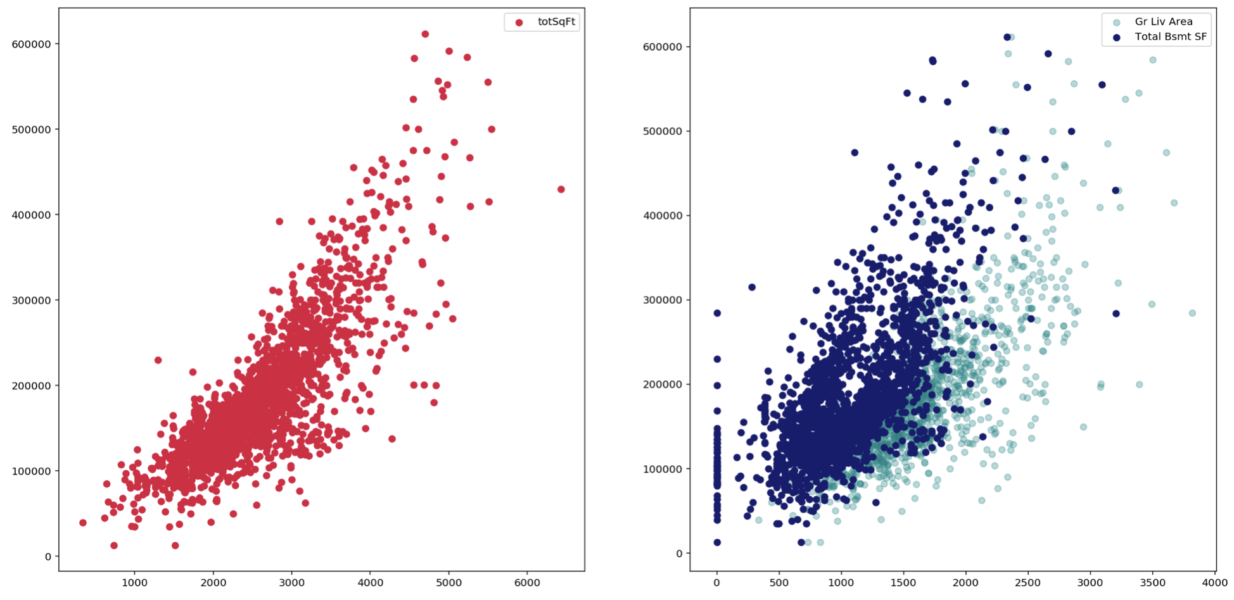
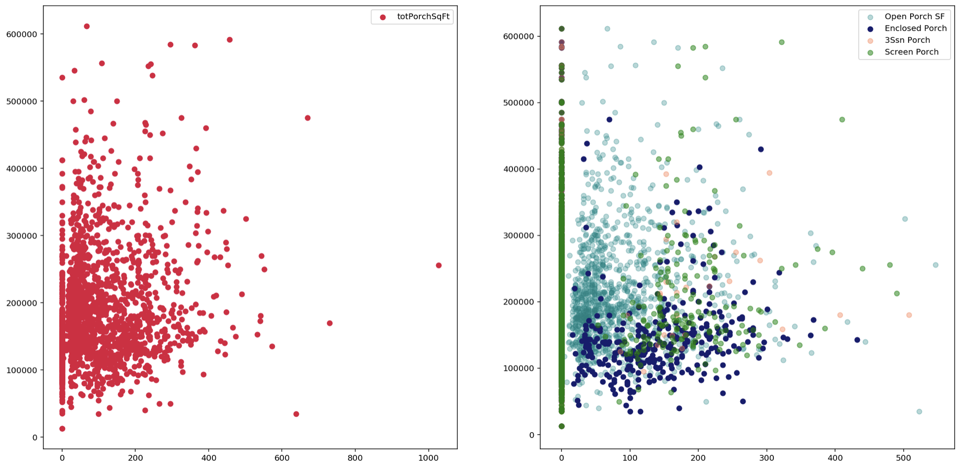
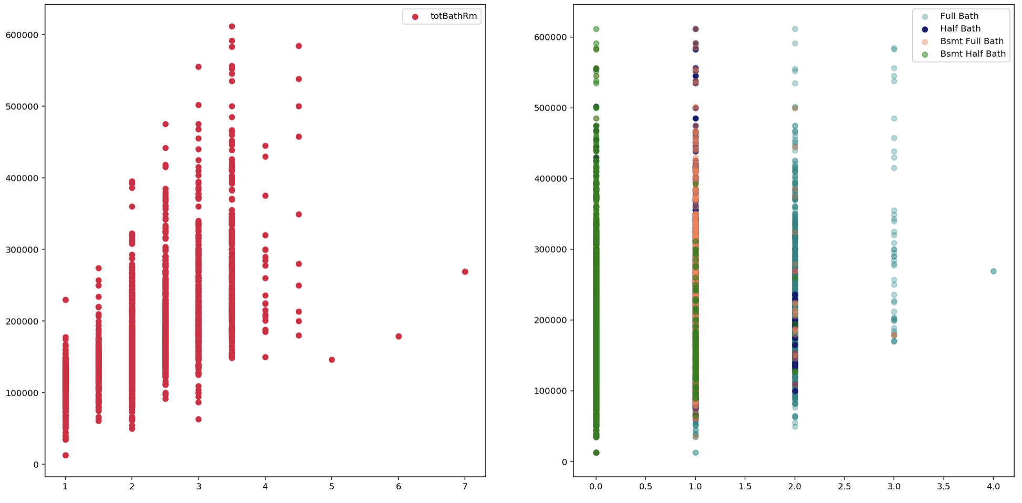
Feature engineering – Making sense with the Features

Slide 12
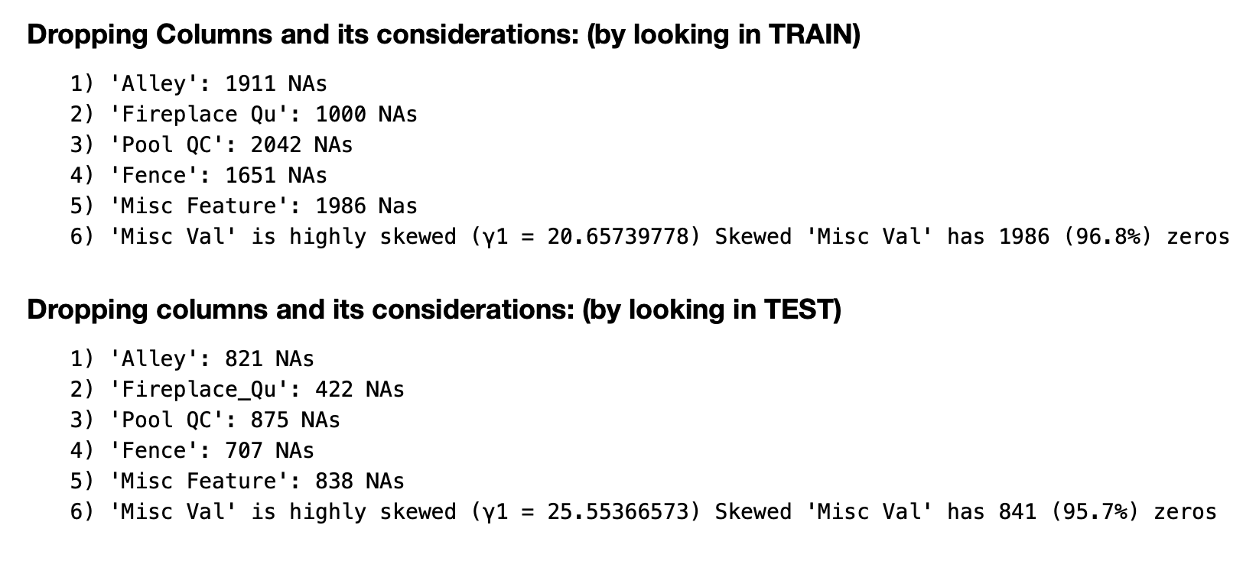
Dropping Features with significant number of nulls

Slide 13
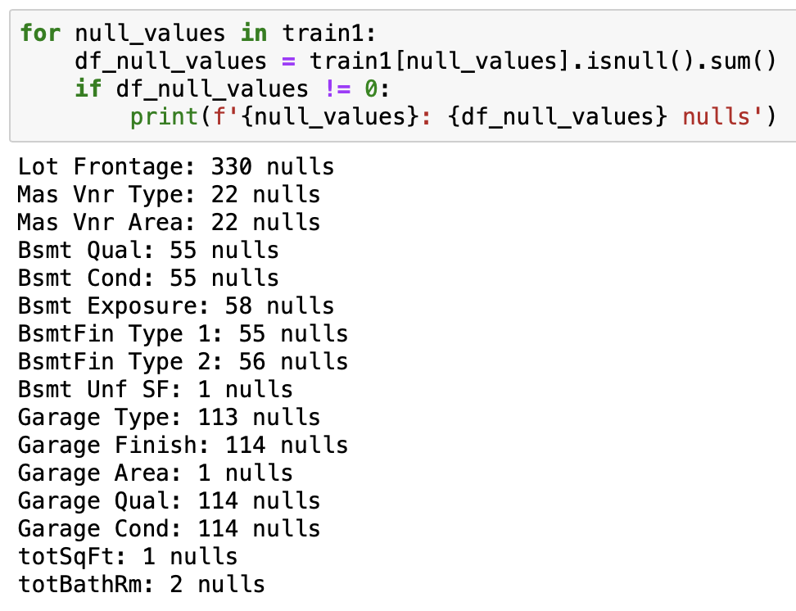
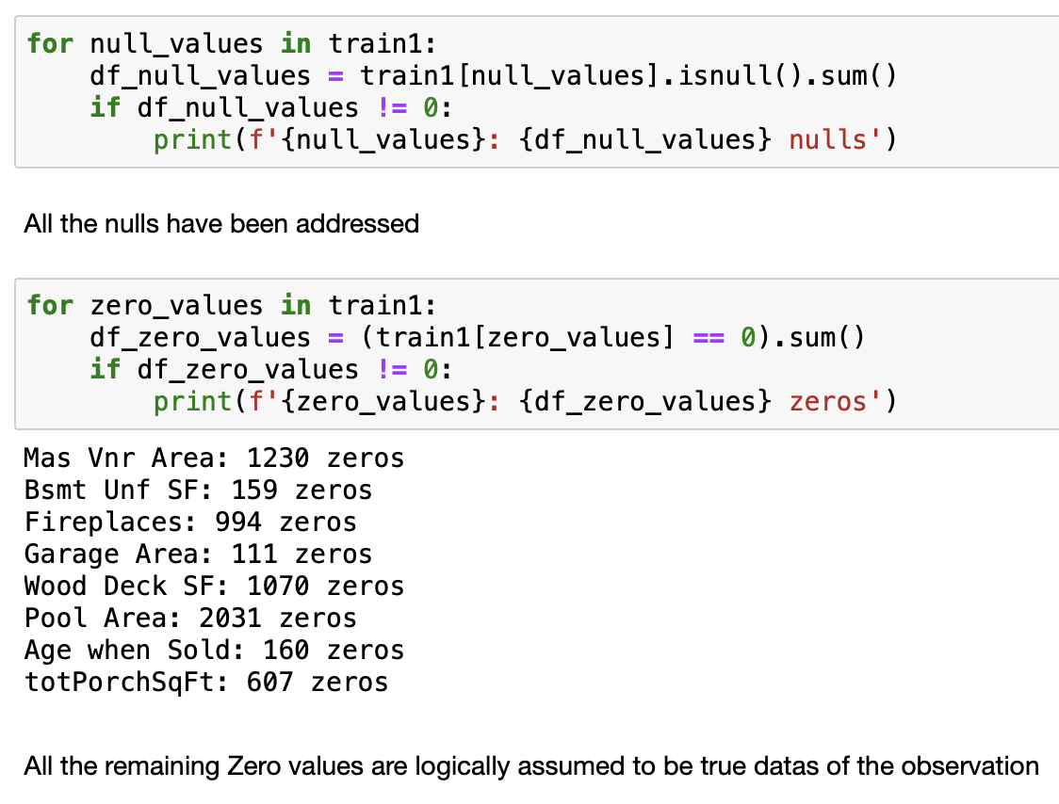
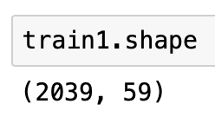
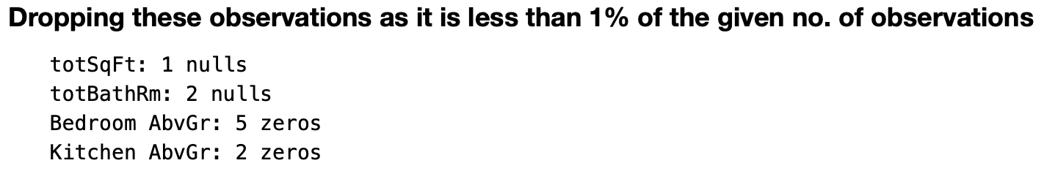
Handling Null Values

Slide 14
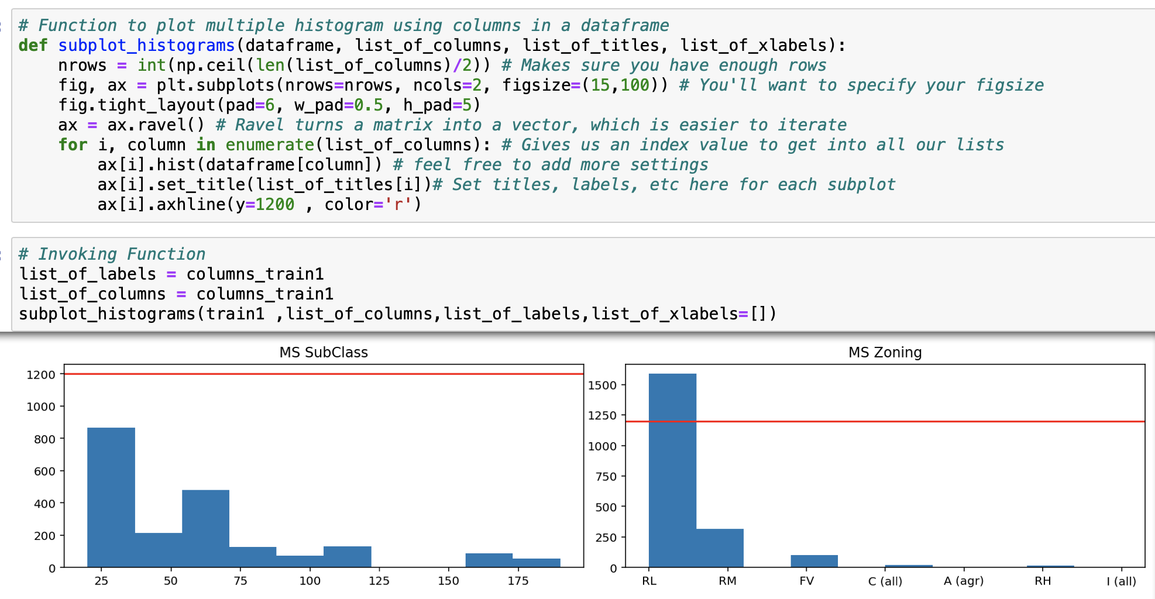
Plotting histogram and setting threshold level to eliminate variables

Slide 15
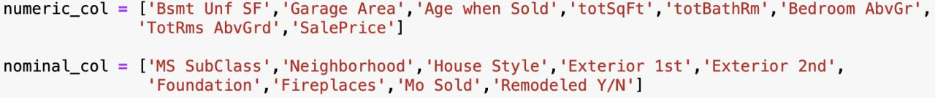
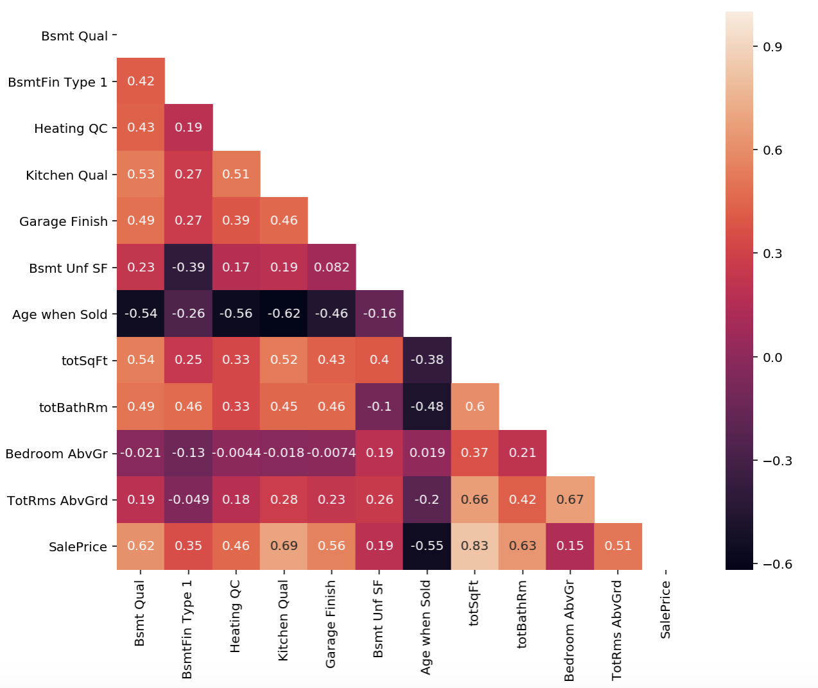
Segregating the remaining 24/23 variables to their types

Slide 16
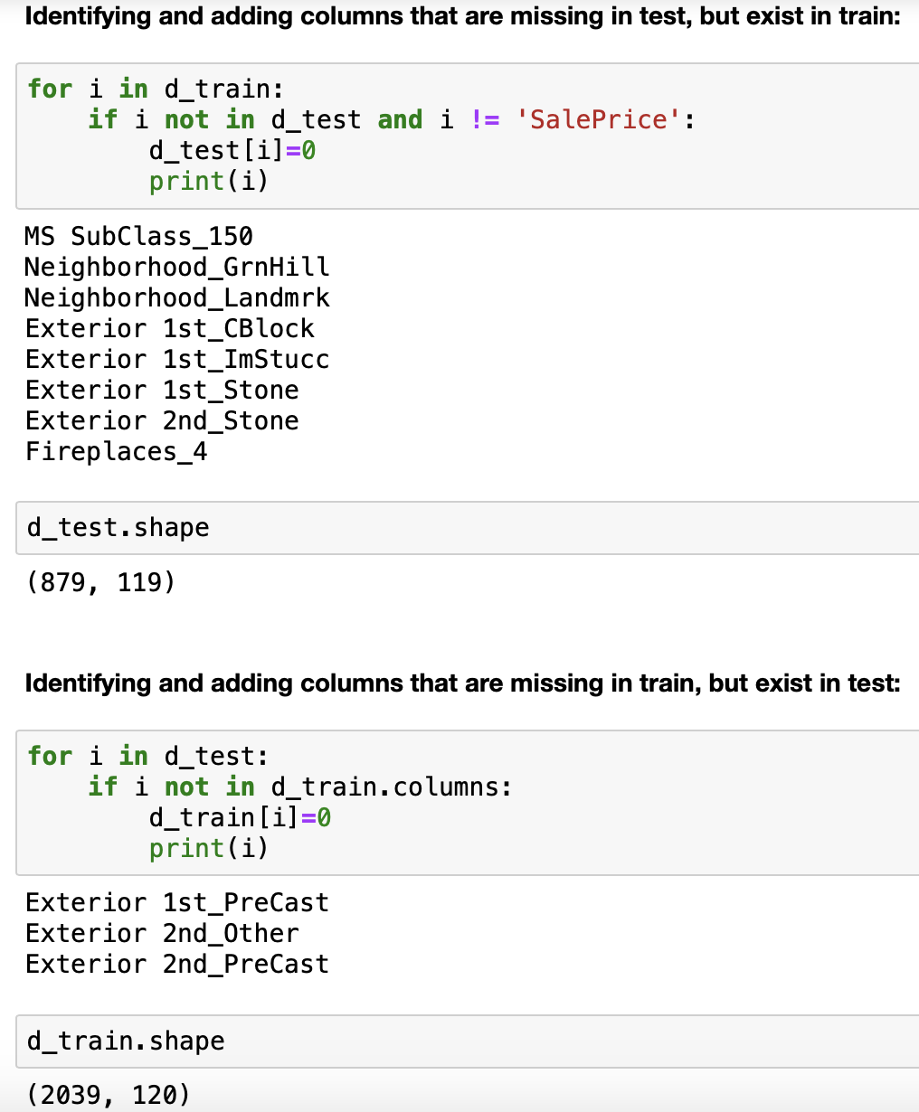
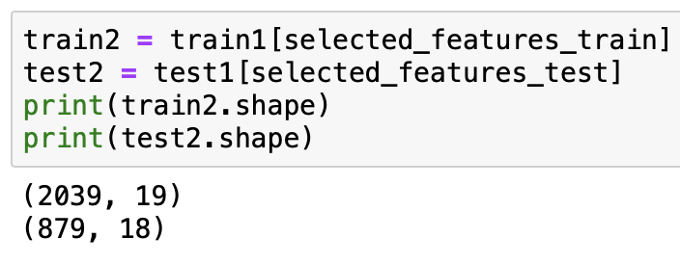
Before & After one-hot encoding

Slide 17
Modelling
Select all the 120 features, create feature matrix X, and target vector y
Standard Scaling
Linear Regression
Regularization – Ridge, Lasso, Elastic Net
Identify which model gives highest score (Ridge highest)
Taking out the coefficients generated by Lasso, Absolute, and rank them
Pick the top 20, and repeat step 3 & 4
Predict using Ridge model against Test Dataset

Slide 18
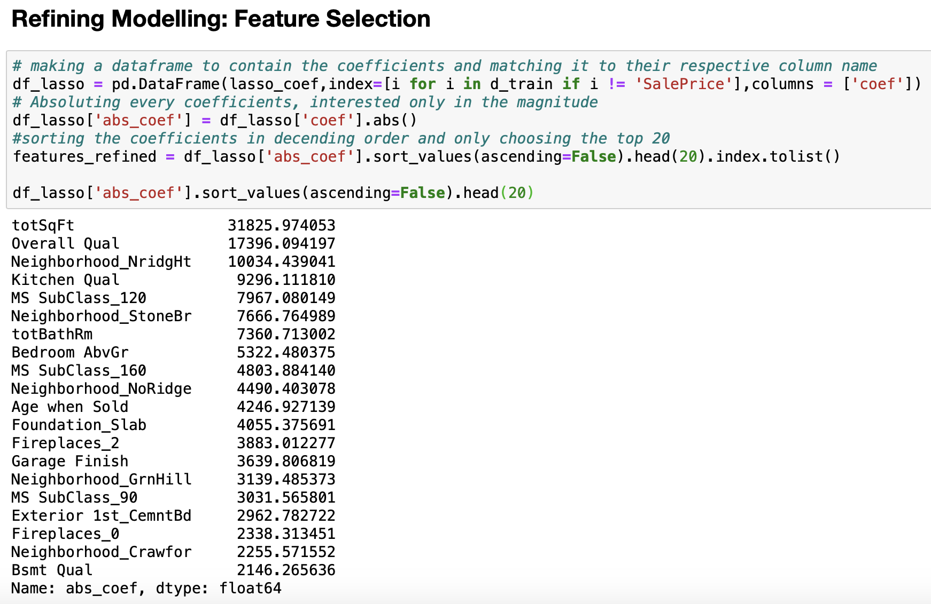
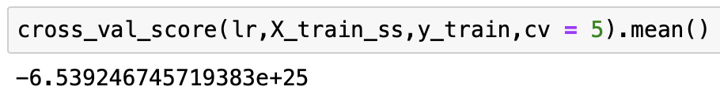
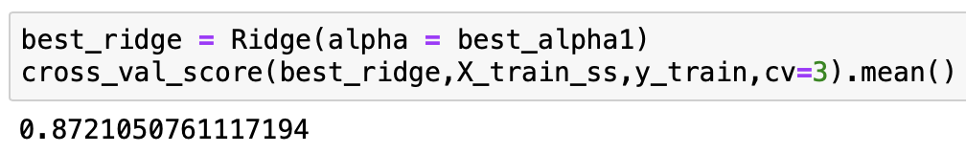
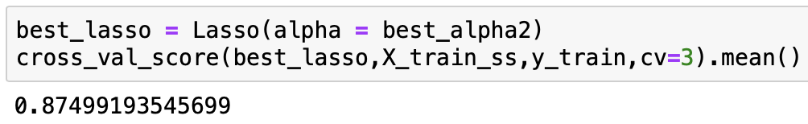
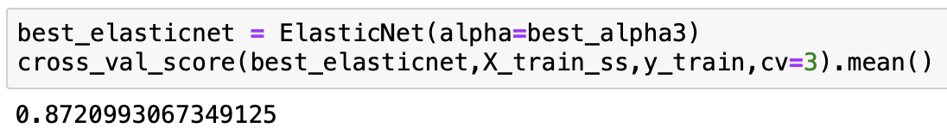
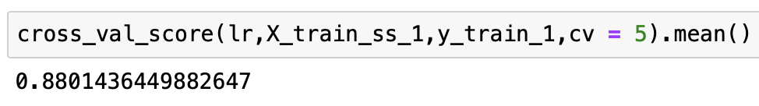
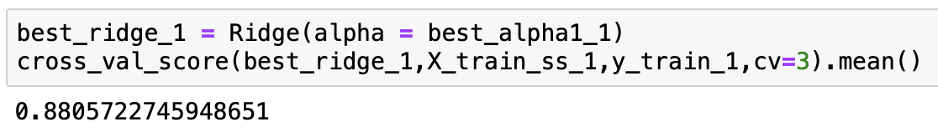
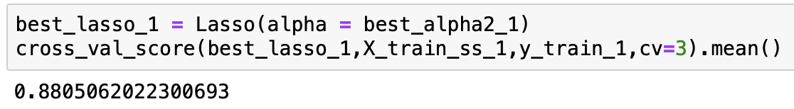
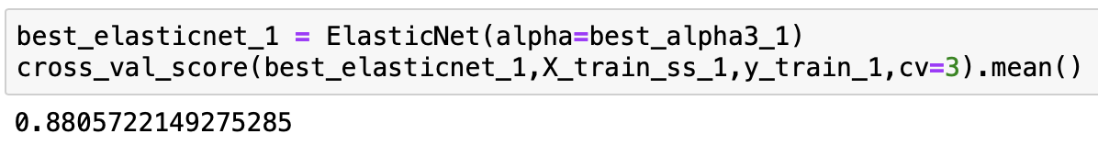
Results from step 3-8

